Slide 1
Maxima and Minima
Nazmul Kader Chowdhury

Slide 2
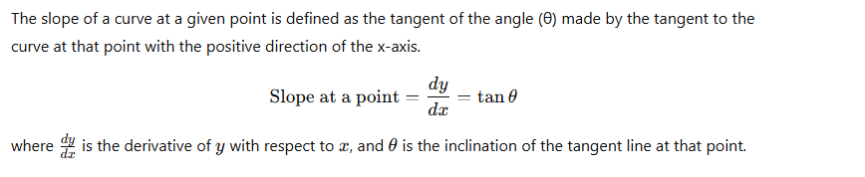
What is slope?

Slide 3
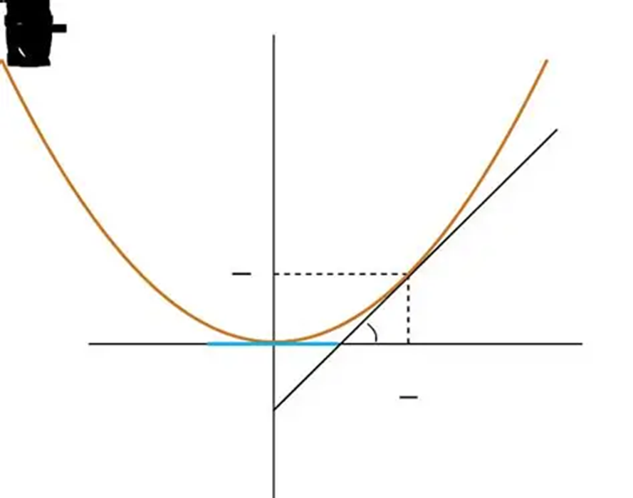
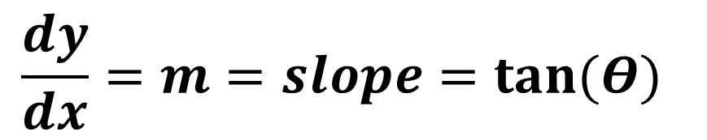
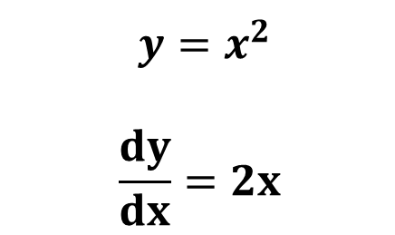
How to find slope at any points?
$$\frac{dy}{dx}=m=slope=tan⁡(Θ)$$
$$y=x^{2}$$
$$\frac{dy}{dx}=2x$$

Slide 4
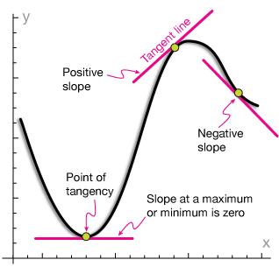

Slide 5
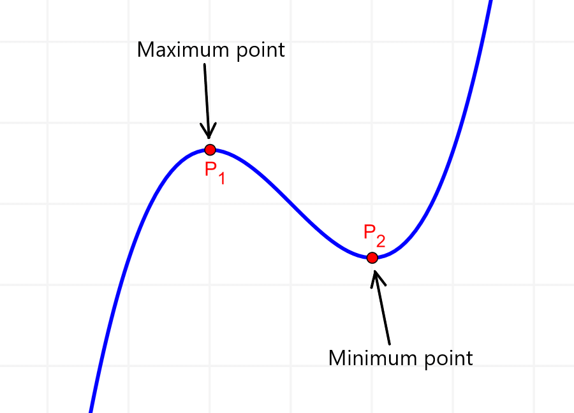

Slide 6
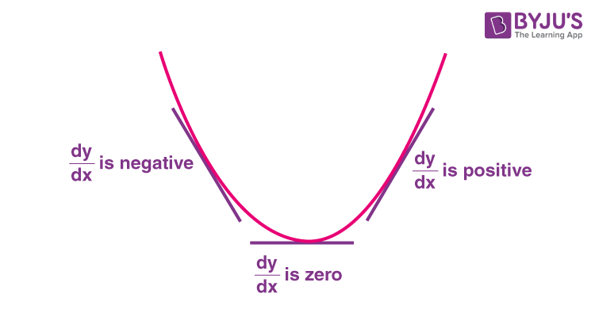




Slide 7
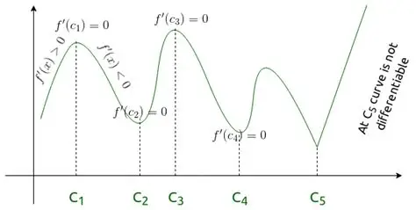

Slide 8
$${f\left(x\right)=x}^{3}−3x^{2}−45x+13$$
Check whether the function is increasing or decreasing at x=4
Check whether the function is increasing or decreasing at x=7
c) Find the value of x where maximum and minimum value can be found.
d) Find the maximum and minimum value .
d)Find the interval where the function is increasing
e) Find the interval where the function is decresing

Slide 9
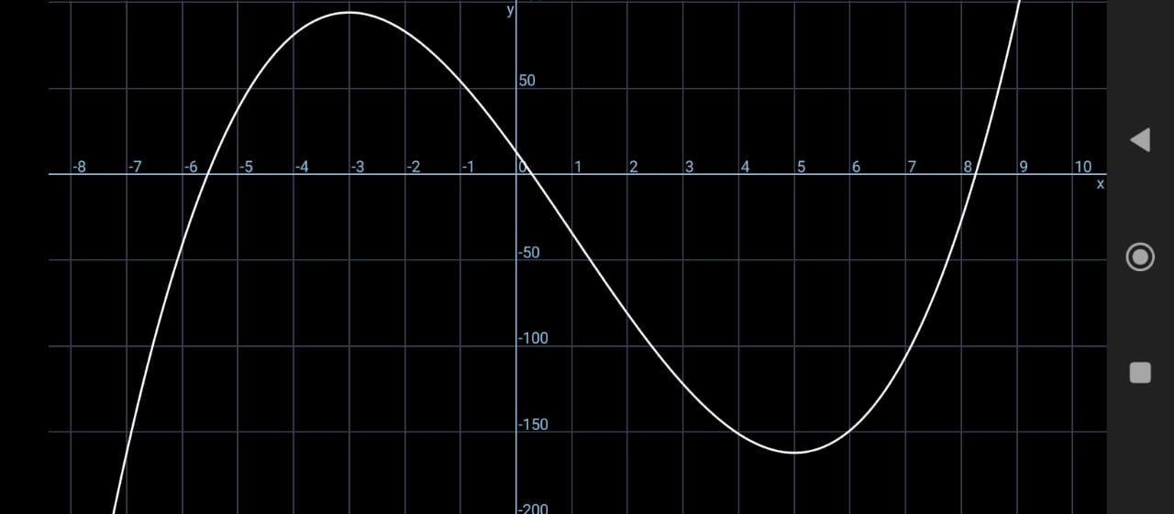

Slide 10
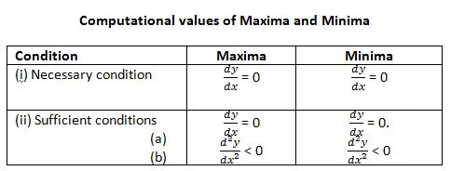

Slide 11
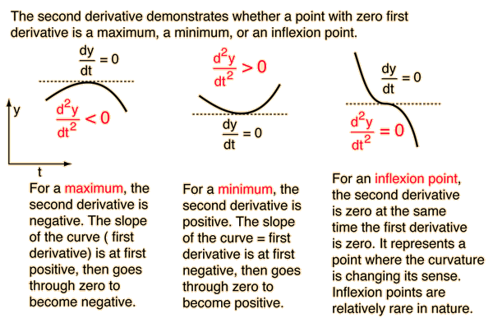

Slide 12
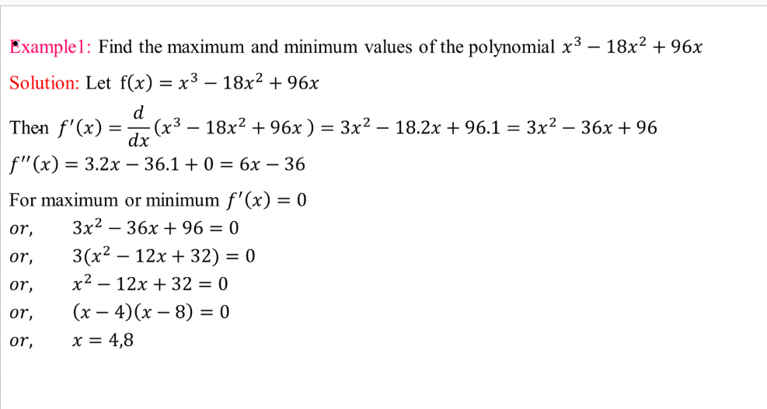

Slide 13
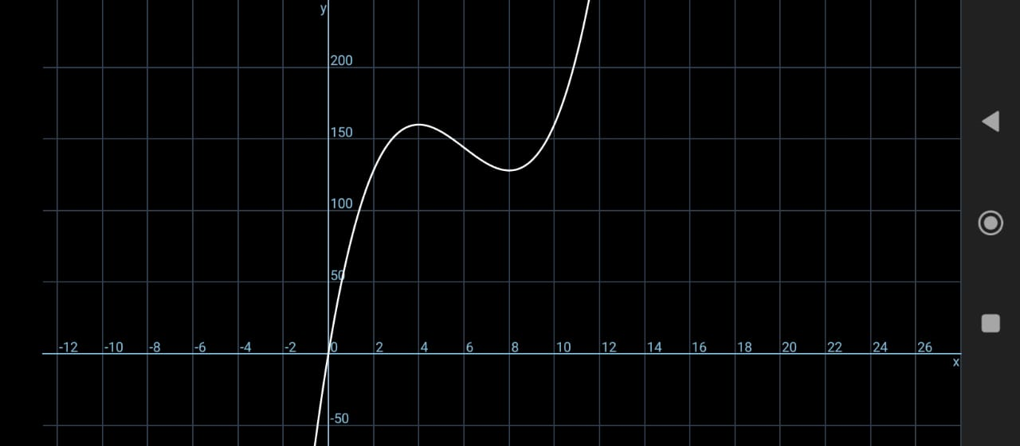

Slide 14
